Slide 1
LGE Internal Use Only
Embedded Linux using Yocto
^{01st} Dec, 2021

Slide 2
Agenda
Introduction about Yocto
Quick start with poky
Concepts in Yocto
Practice with layer, bitbake
Notes:
2

Slide 3
Agenda
Introduction about Yocto
Quick start with poky
Concepts in Yocto
Practice with layer, bitbake
Notes:
3

Slide 4

Embedded Linux
Embedded Linux is a type of Linux operating system/kernel that is designed to be installed and used within embedded devices
Four elements of embedded Linux
Toolchain: The compiler and other tools needed to compile code for your target device. Everything else depends on the toolchain. Initially, you need one to build the other three elements of an embedded Linux system: the bootloader, the kernel, and the root filesystem.
Bootloader: The program that initializes the board and loads the Linux kernel.
Kernel: This is the heart of the system, managing system resources and interfacing with hardware.
Root filesystem: Contains the libraries and programs that are run once the kernel has completed its initialization.
One more element can be collection of programs specific to your embedded application which make the device do whatever it is supposed to do, be it weigh groceries, display movies, control a robot, or fly a drone.

Slide 5


What is Yocto Project?
Yocto project provides open source, high quality infrastructure and tools to help developers create their own custom Linux distributions for any hardware architecture.
History:
Founded in 2010, in an effort to reduce work duplication, provide resources and information catering to both new and experienced users.
Collaboration of
Many hardware manufacturers
Open source operating systems vendors
Electronics companies
https://www.yoctoproject.org

Slide 6
What is Yocto Project?
To understand the outcome provided by the Yocto Project, we can use the analogy of the computing machine
Input: Set of data that describes what we want, that is our specification
(Kernel Configuration, Hardware Name, Packages/Binaries to be installed)
Output: Linux Based Embedded Product
(Linux Kernel, Root File System, Bootloader, Device Tree)

Slide 7
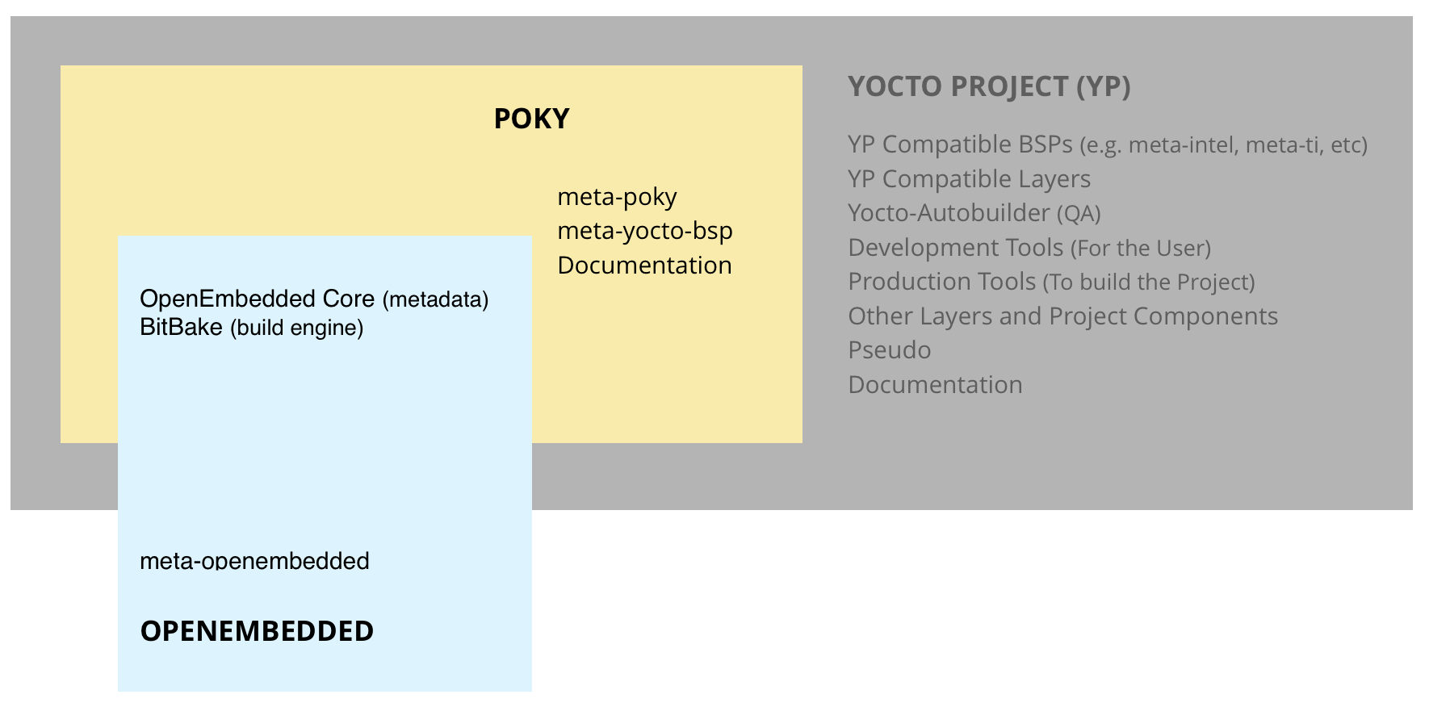
What is Poky?
Poky is a reference distribution of Yocto Project. The word "reference" is used to mean "example".
Yocto Project uses Poky to build images (kernel, system, and application software) for targeted hardware.
At the technical level it is a combined repository of the components
Bitbake
OpenEmbedded Core
meta-yocto-bsp
Documentation
Note: Poky does not contain binary files,it is a working example of how to build your own custom Linux distribution from source.
What is difference between poky and Yocto?
The exact difference between Yocto and Poky is Yocto refers to the organization and Poky refers to the actual bits downloaded

Slide 8
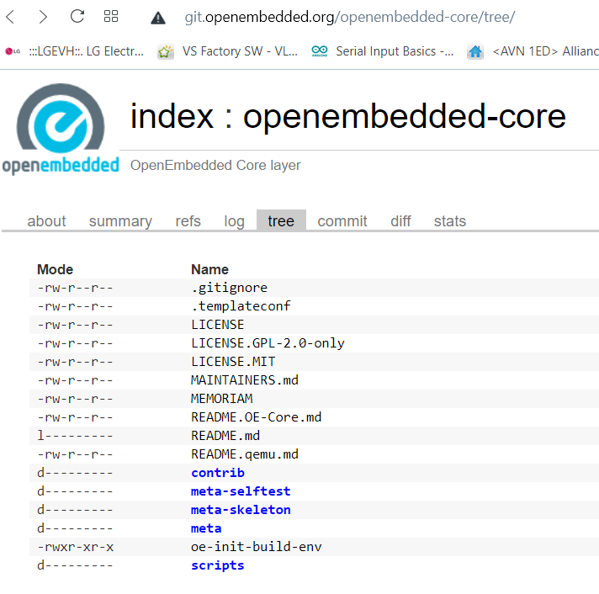
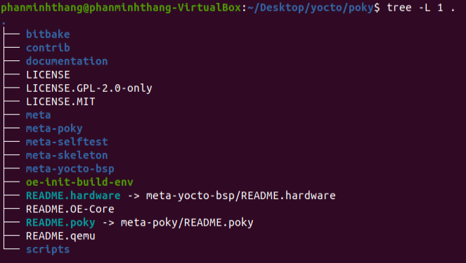
Directory struct: Openembedded-core (meta)
openembedded-core
Poky

Slide 9
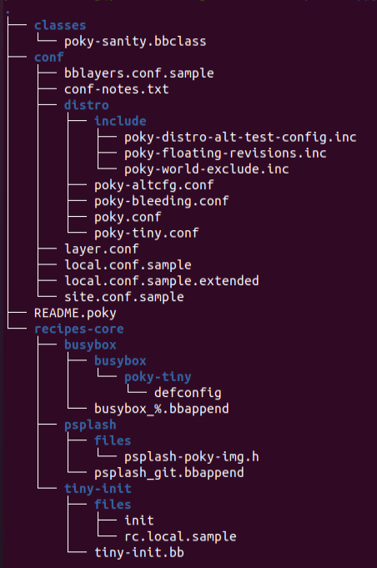
Directory struct: meta-poky
meta-poky, which is Poky-specific metadata

Slide 10
Directory struct: meta-yocto-bsp
A Board Support Package (BSP) is a collection of information that defines how to support a particular hardware device, set of devices, or hardware platform
The BSP includes information about the hardware features present on the device and kernel configuration information along with any additional hardware drivers required.
The BSP also lists any additional software components required in addition to a generic Linux software stack for both essential and optional platform features.
The meta-yocto-bsp layer in Poky maintains several BSPs such as the Beaglebone, EdgeRouter, and generic versions of both 32-bit and 64-bit IA machines.
Machines supported
Texas Instruments BeagleBone (beaglebone)
Freescale MPC8315E-RDB (mpc8315e-rdb)
Intel x86-based PCs and devices (genericx86 and genericx86-64)
Ubiquiti Networks EdgeRouter Lite (edgerouter)
Note: To develop on different hardware, you will need to complement Poky with hardware-specific Yocto layers.
Yocto source repositories, we can find some other supported BSP: https://git.yoctoproject.org

Slide 11
Agenda
Introduction about Yocto
Quick start with poky
Concepts in Yocto
Practice with layer, bitbake
Notes:
11

Slide 12
Quick start with poky: Prerequisites for Poky
50 Gbytes of free disk space
Runs a supported Linux distribution (i.e. recent releases of Fedora, openSUSE, CentOS, Debian, or Ubuntu).
Git 1.8.3.1 or greater tar 1.27 or greater Python 3.4.0 or greater.
Packages and package installation vary depending on your development system.
(*) Install the required packages for Yocto to Work from https://www.yoctoproject.org/docs/latest/ref-manual/ref-manual.html#ubuntu-packages
For ubuntu
$ sudo apt-get install gawk wget git-core diffstat unzip texinfo gcc-multilib \ build-essential chrpath socat cpio python python3 python3-pip python3-pexpect \ xz-utils debianutils iputils-ping python3-git python3-jinja2 libegl1-mesa libsdl1.2-dev \ pylint3 xterm

Slide 13
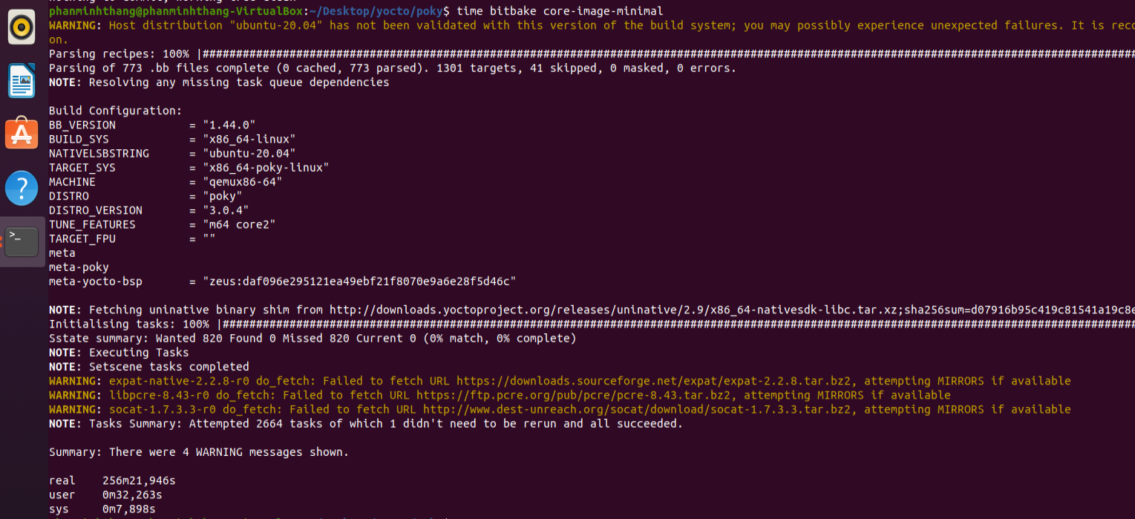
Quick start with poky: how to build and run
git clone git://git.yoctoproject.org/poky
git checkout zeus
source poky/oe-init-build-env [ build_directory ] -> create build directory
bitbake core-image-minimal
runqemu
Notes:
Demo runqemu

Slide 14
Agenda
Introduction about Yocto
Quick start with poky
Concepts in Yocto
Practice with layer, bitbake
Notes:
14

Slide 15
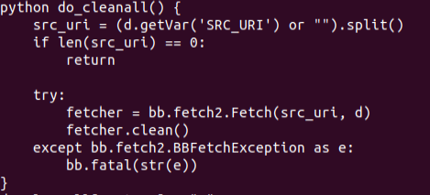
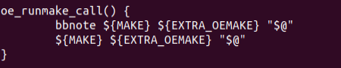
Terminology: Bitbake
Bitbake is a core component of the Yocto Project.
It basically performs the same functionality as of make.
It's a task scheduler that parses python and shell script mixed code
The code parsed generates and runs tasks, which are basically a set of steps ordered according to code's dependencies.
It reads recipes and follows them by fetching packages, building them and incorporating the results into bootable images.
It keeps track of all tasks being processed in order to ensure completion, maximizing the use of processing resources to reduce build time and being predictable.
Notes:
Việc chia nhỏ thành các task để có thể chạy được song song khi build các recipes mà vẫn control đc dependence

Slide 16
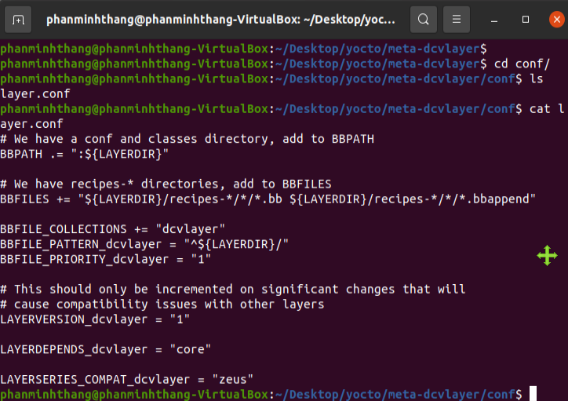
Terminology: Metadata
Yocto:
Metadata refers to the build instructions
Data used to control what things get built and to affect how they are build
Commands and data used to indicate what versions of software are used
Where they are obtained from
Changes or additions to the software itself (patches) which are used to fix bugs or customize the software for use in a particular situation
Metadata is collection of
Configuration files (.conf)
Recipes (.bb and .bbappend)
Classes (.bbclass)
Includes (.inc)

Slide 17
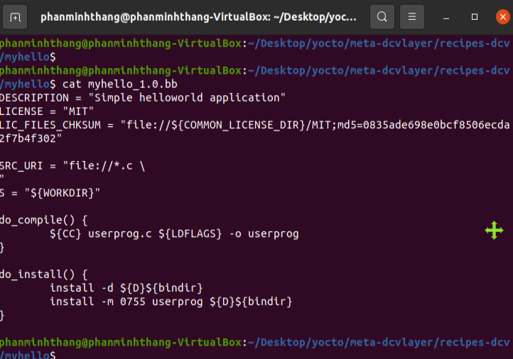
Terminology: Recipes
Yocto: A recipe is a set of instructions that is read and processed by the bitbake
Extension of Recipe: .bb
A recipe describes:
Where to get source code: upstream project release, SCM, local project
Which patches to apply
Configuration options
Compile options (library dependencies)
Install
License

Slide 18
Terminology: Configuration file
Files which hold:
Global definition of variables
User defined variables and
Hardware configuration information
They tell the build system what to build and put into the image to support a particular platform
Extension: .conf (bitbake.conf, local.conf, bblayers.conf, layer.conf…)
Types
Machine Configuration Options ({machine}.conf)
Distribution Configuration Options
Compiler tuning options
General Common Configuration Options (bitbake.conf define variable…)
User Configuration Options (local.conf)

Slide 19
Terminology: Class
Class files are used to abstract common functionality and share it amongst multiple recipe (.bb) files
To use a class file, you simply make sure the recipe inherits the class
Eg. inherit classname
Extension: .bbclass
They are usually placed in classes directory inside the meta* directory
Example of classes
cmake.bbclass - Handles cmake in recipes
kernel.bbclass - Handles building kernels. Contains code to build all kernel trees
base.bbclass – default inherit when a bb is built

Slide 20
Terminology: Layer
A collection of related recipes. Or Layers are recipe containers (folders)
Typical naming convention: meta-<layername>
Poky has the following layers:
meta, meta-poky, meta-selftest, meta-skeleton, meta-yocto-bsp
Why Layers
Layers provide a mechanism to isolate meta data according to functionality, for instance BSPs, distribution configuration, services, application…
You could have a BSP layer, a GUI layer, a distro configuration, middleware, or an application
Putting your entire build into one layer limits and complicates future customization and reuse.
Example:
meta-poky -- Distro metadata;
meta-yocto-bsp -- BSP metadata
Layers allow to easily to add entire sets of meta data and/or replace sets with other sets.

Slide 21
Terminology: Layer
Which layers are used by Poky build system?
BBLAYERS variable present in build/conf/bblayers.conf file list the layers Bitbake tries to find
If bblayers.conf is not present when you start the build, the OpenEmbedded build system creates it from bblayers.conf.sample when you source the oe-init-build-env script
Command to find out which layers are present
$ bitbake-layers show-layers
Note: You can include any number of available layers from the Yocto Project

Slide 22
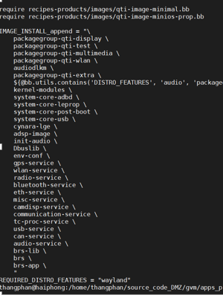
Terminology: Image
An image is the top level recipe, it has a description, a license and inherits the core-image class
It is used alongside the machine definition
Machine describes the hardware used and its capabilities
Image is architecture agnostic and defines how the root filesystem is built, with what packages.
By default, several images are provided in Poky
Command to check the list of available image recipes
$ ls meta*/recipes*/images/*.bb

Slide 23
Terminology: Packages
Yocto: A package is a binary file with name *.rpm, *.deb, or *.ipkg
A single recipe produces many packages. All packages that a recipe generated are listed in the recipe variable
$ vi meta/recipes-multimedia/libtiff/tiff_4.0.10.bb
PACKAGES =+ "tiffxx tiff-utils"

Slide 24
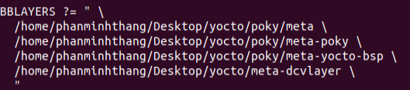
Create Recipe: Bitbake operator syntax
Basic Variable Setting (=): This assignment occurs immediately as the statement is parsed
VARIABLE = “ value “ (space retailed)
How to check the value of variable? bitbake recipe_name -e | grep ^VARIABLE=
Line Joining
Soft assignment(?=): define a variable if it is undefined when the statement is parsed (MACHINE ?= "qemuarm“)
Weaker default value (??=): Assignment is made at the end of the parsing process rather than immediately. When multiple "??=" assignments exist, the last one is used
Variable Expansion: The "=" operator does not immediately expand variable references in the right-hand side, Instead, expansion is deferred until the variable assigned to is actually used
A = "hello“
B = "${A} world"
Immediate Variable Expansion (:=)
Appending operators (+= or .=) Difference between += and .= is space is automatically added in +=, These operators take immediate effect during parsing
Appending and Prepending (Override Style Syntax): An advantage of the override style operations "_append", "_prepend", and "_remove" as compared to the "+=" and "=+" operators is that the override style operators provide guaranteed operations

Slide 25
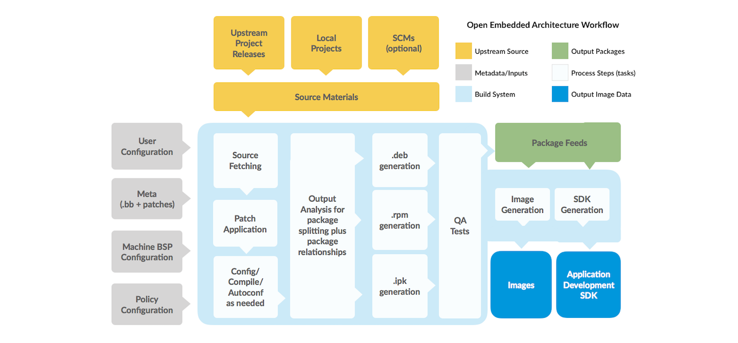
Build system works: the workflow

Slide 26
Build system works: Build folder
source poky/oe-init-build-env, it will create a "build" folder
Inside this build folder, it will create "conf" folder which contains two files:
1. local.conf
2. bblayers.conf

Slide 27
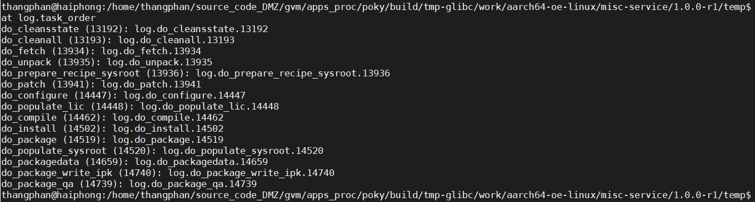
Build system works: Task orders
Bitbake’s fundamental unit of work is a task
Bitbake works on a “per-task” basic rather than a “per-recipe” basic to determine what parts of the system need to be build.
A task is a shell or Python script that gets executed to accomplish something, usually generating some form of out put
Eg. do_install, do_package
Bitbake will execute the tasks with as much parallelism as possible while maintaining dependency order

Slide 28
Build system works: Images generated by Poky Build
The build process writes images out to the Build Directory inside the tmp/deploy/images/{machine}/ folder
kernel-image:
A kernel binary file
The KERNEL_IMAGETYPE variable determines the naming scheme for the kernel image file.
$ bitbake -e core-image-minimal | grep ^KERNEL_IMAGETYPE=
root-filesystem-image:
Root filesystems for the target device (e.g. *.ext3 or *.bz2 files).
The IMAGE_FSTYPES variable determines the root filesystem image type
$ bitbake -e core-image-minimal | grep ^IMAGE_FSTYPES=
kernel-modules:
Tarballs that contain all the modules built for the kernel
bootloaders:
If applicable to the target machine, bootloaders supporting the image.

Slide 29
Build an image
Package (Main)
Recipe 1
Package (dbg)
Image bb file
(top level recipe)
Image
Package (staticdev)
Recipe 2
Package (Main)

Slide 30
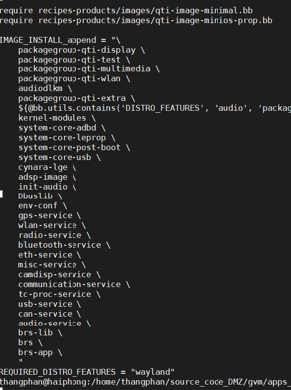
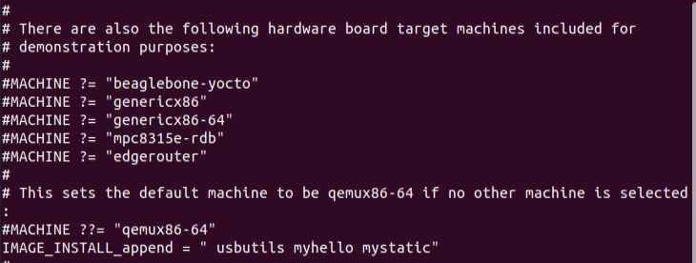
Build an image: package append to image
bitbake –e myhello | grep ^PACKAGES=

Slide 31
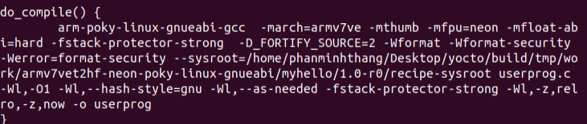
Cross compiler
How to cross compile for C, C++ program
Do_prepare_recipe_sysroot will setup cross compiler
Recipe-sysroot-native: for build by host system, cross-compilation process
To see what compiler is used build/tmp/work/armv7vet2hf-neon-poky-linux-gnueabi/myhello/1.0-r0/temp/run.do_compile

Slide 32
Agenda
Introduction about Yocto
Quick start with poky
Concepts in Yocto
Practice with layer, bitbake
Notes:
32

Slide 33
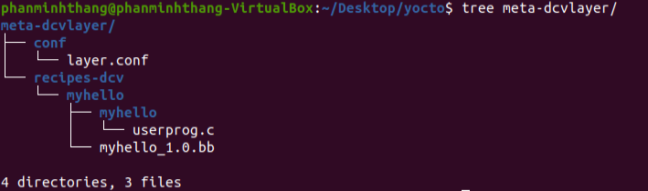
Create a layer
Step1: Create a directory for the layer. For example meta-dcvlayer
Step2: Create a conf/layer.conf
Step3: Update bblayers.conf with new layer

Slide 34
Create Recipe (practice)
Step 1: Create a file userprog.c with the following content:
#include <stdio.h>
int main()
{
printf("Hello World\n");
return 0;
}
Step 2: Create a folder in the layer recipes-example 'myhello'
mkdir -p recipes-examples/myhello
Step 3: Create 'files' folder inside the 'myhello' folder and copy userprog.c inside this folder
mkdir -p recipes-examples/myhello/files
Copy the userprog.c into the above location
Step 4: Create a file called 'myhello_0.1.bb' with the following content:
DESCRIPTION = "Simple helloworld application"
LICENSE = "MIT"
LIC_FILES_CHKSUM = "file://${COMMON_LICENSE_DIR}/MIT;md5=0835ade698e0bcf8506ecda2f7b4f302"
SRC_URI = "file://userprog.c"
S = "${WORKDIR}"
do_compile() {
${CC} userprog.c ${LDFLAGS} -o userprog
}
do_install() {
install -d ${D}${bindir}
install -m 0755 userprog ${D}${bindir}
}
Step 5: bitbake myhello

Slide 35
Create static library (practice)
Create object Files
$gcc -c arith.c
$gcc -c print.c
Create Static library
$ar rcs liblwl.a arith.o print.o
Linking static library into application
$ gcc -I. userprog.c -o userprog -ldcv -L.

Slide 36
Create dynamic library (practice)
Step1: Create object files using the below command
$ gcc -fPIC -c *.c
the -fPIC flag stands for Position Independent Code, a characteristic required by shared libraries
Step2: Create the library
$ gcc -shared -Wl,-soname,libdcv.so.1 -o libdcv.so.1.0 *.o
Step3: Use the dynamic library
ln -s libdcv.so.1.0 libdcv.so.1
ln -s libdcv.so.1 libdcv.so
gcc -I. userprog.c -L. -ldcv -o userprog

Slide 37
Dependency
Build time dependencies: required when the sw is built.
Runtime dependencies: require to be installed on the target in order for sw to execute
DEPENDS variable: build-time depend, list of recipes to build prior to the recipe
RDEPENDS: install before current package

Slide 38
Dependency: DEPENDS
Recipe A depend on Recipe B mean before task do_configure of A run, the task do_populate_sysroot of B must be completed
Do_populate_sysroot copy subset of files installed by
Sysroot for target machine, sysroot for build host
Do_prepare_recipe_sysroot will setup 2 sysroots
Recipe-sysroot: target host
Recipe-sysroot-native: for build by host system, cross-compilation process

Slide 39
bbappend (practice)
I. Extending a Recipe
It is a good practice not to modify recipes available in Poky
But it is sometimes useful to modify an existing recipe
1. Copy Approach:
Copy recipe in your layer and make modifications in the recipe
2. Extend Approach:
The BitBake build engine allows to modify a recipe by extending it
II. What is Bitbake Append?
A recipe that appends Metadata to another recipe is called a BitBake append file.
File Extension: .bbappend
We can use a .bbappend file in a layer to make additions or changes to the content of another layer's recipe without having to copy the other layer's recipe into your layer
.bbappend file resides in our layer
.bb recipe file to which we are appending Metadata resides in a different layer.

Slide 40
Some useful commands
bitbake –e myhello | grep ^WORKDIR=
bitbake-layers show-layers
bitbake-layers show-recipes -f myhello
bitbake-layers show-appends
oe-pkgdata-util find-path /usr/bin/qcarcam_test

Slide 41
Offline build
Create clean downloads directory (DL_DIR) (remove downloads directory)
BB_GENERATE_MIRROR_TARBALLS = “1”
Run bitbake image –runonly=fetch
After fetch we can copy downloads directory to other server and build

Slide 42
Q&A
Thank You
01st Dec 2021
Notes:
42

